Slide 1
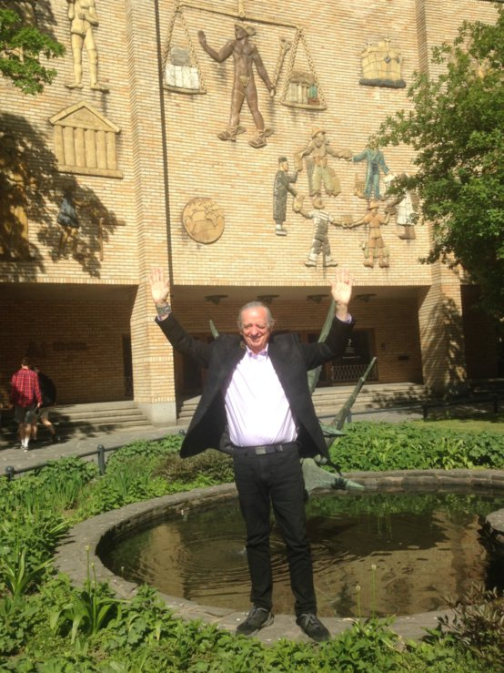
Living Story alternatives to Western Narrative Globalization and Human Extinction
David M. Boje, Ph.D.
Slides & books at
http://davidboje.com/Finland

Slide 2
Finland’s story shows equality is the best route to happiness
Finland is the happiest country in the world, says UN report
USA →with a crisis of obesity, substance abuse and depression is Unhappiest country.
Free healthcare and university education goes a long way when it comes to happiness
Notes:
Zygmunt Bauman (2000) call is Liquid Modernity and Liquid Times (2007). His assessment is that globalization morphed from Fordism (phase III) to Post-Fordism and US Globalization (Phase IV), from stability of nation-state control to the instability, uncertainty, and disaster of Phase IV, where we are now stuck, with no way out.

Slide 3
Aalto-yliopisto

Slide 4
Who Will Inherit the Earth?
At the end there will be two cockroaches and Keith Richards.

Slide 5
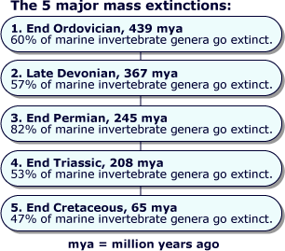
150 years ago FINLAND suffered Europe’s last naturally caused famine

Slide 6
What is 6th Extinction
Sixth Mass Extinction is a massive die-off of plants and animals all across the planet.
6th Extinction is 10 to 100 times greater than any previous mass extinction

Slide 7
What is Globalization doing to End the World in your children’s children’s lifetime?
Results of focus groups so far, when asked: What was #1 Extinction threat that can bring about end of the world?
Donald J. Trump
Climate Change
Nuclear War
Pandemic
Introduction of Exotic Species
Deforestation/Habitat Loss
Pollution
Non-human causes →Asteroid, Alien Invasion, etc.
Extinction Event: causes drastic change in # of species in short period of geologic time

Slide 8
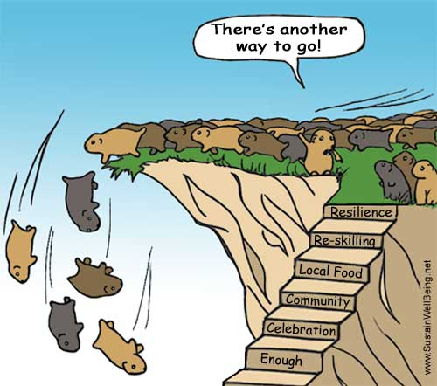
Myth: Globalization has no alternative

Slide 9
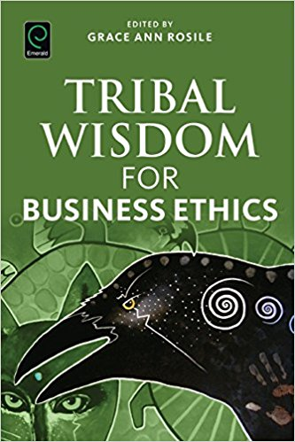
IWOK – Indigenous Ways of Knowing in Living Story Webs of Relations to Community & Earth Kaua e takahia te mana o te tangata Nga Huia Te Awe Kotuku – Don’t trample on the integrity of the people -- cited in Tuhiwai Smith 1999: 120

Slide 10
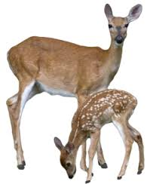
What is Living Story Web?
“Grandpa John told me endless stories about young men who had opportunities to live up to their names. One day, he said, ‘there was a young man named Looks Twice---really, he was more like a boy---who left his village alone to hunt, hoping to bring back some meat. He wanted to prove that he was a man. It was in the springtime. He went without a bow or a lance, and he killed a deer with his knife.’… ‘How did he kill the deer, Grandpa?’ I interrupted. ‘You’d better figure that out,’ he said. ‘That’s what will make you a man.’” (Russell Means, in Fixico, p. 88, as cited in Rosile, 2016: 239).

Slide 11
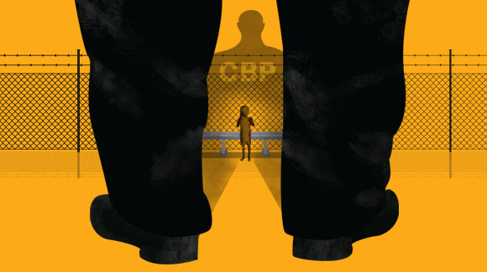
Living Stories look like this too
30,000 documents detailing the physical, sexual, and verbal abuse of immigrant children in the custody of U.S. Customs and Border Protection– ACLU
Threatening children with rape and death
Depriving children of food and water and holding them in freezing and unsanitary detention cells
Shooting children with Tasers and stun guns
Punching & Running over two minors with a patrol vehicles
Subjecting a 16-year-old girl to a search in which they forcefully spread her legs and touched her genitals

Slide 12
Fair Food Program — the unfolding story of increasing compliance through the constant back and forth of audits, investigations, and corrections — over the course of all six seasons of the Program’s operation

Slide 13
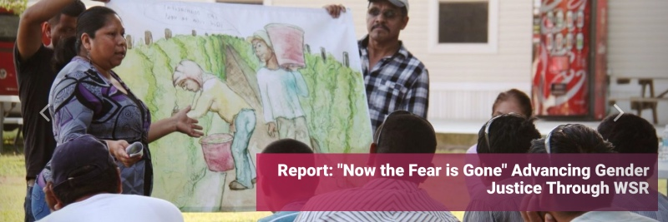
CIW Indigenous Storytelling
“Meet the Farmworkers Leading the #MeToo Fight For Workers Everywhere”… with WORKER DRIVEN SOCIAL RESPONSIBILITY WSR
“By rectifying long-standing power imbalances, Worker-driven Social Responsibility drills into the foundation of the problem…”
“No gender-based violence programs have achieved the same amount of leverage in fostering change…”

Slide 14
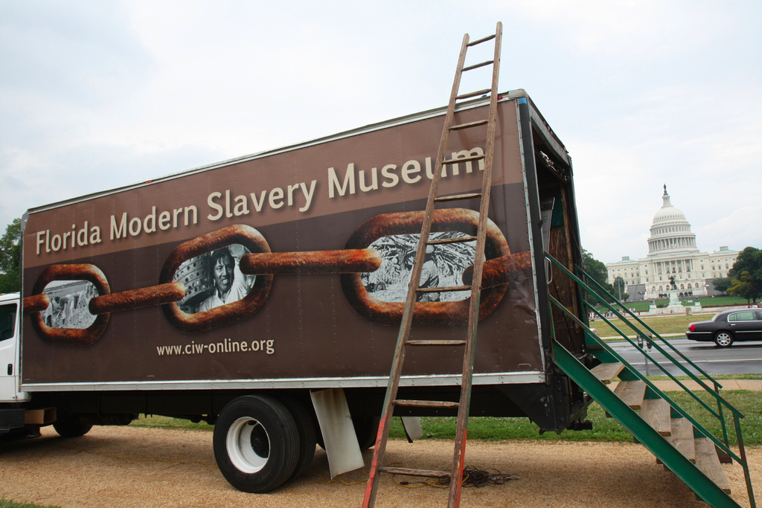
How can you help end global slavery supply chain?
Worker education,
Worker-driven alliances, &
System of alliance of consumers, brands, growers, and workers
This creates revolutionary changes

Slide 16
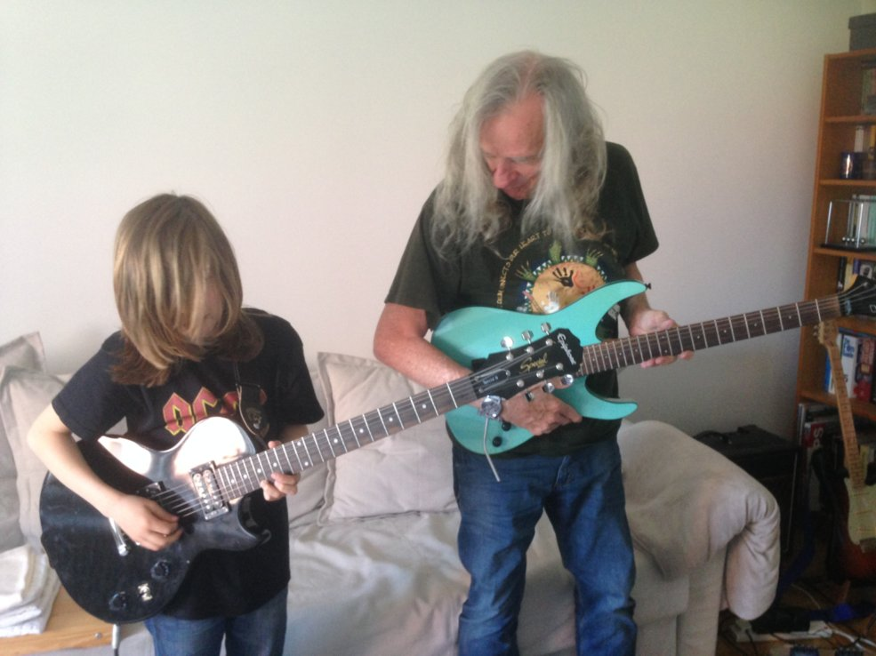
Pause for Q&A

Slide 17
Purchasing-Power-Parity PPP
Based on narrative of a $50 Food basket for family of 4 in USA vs. $1.90 for one in any least developed nation.
World Bank narrative makes it look like Adam Smith ‘invisible hand’ global capitalism is providing poor with drinkable water, affordable housing, food, and health for all
Notes:
World Bank accessed Feb 21 2018 at https://data.worldbank.org/indicator/SI.POV.DDAY
World Bank Oct 2 2016, accessed Feb 21 2018 at http://www.worldbank.org/en/topic/poverty/overview

Slide 18
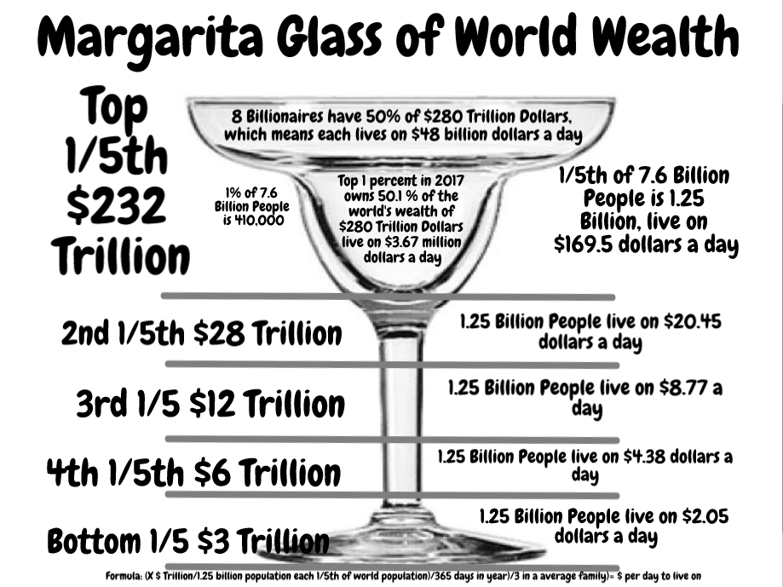
Boje’s Counternarrative to Neoliberal Price Parity Narrative

Slide 19
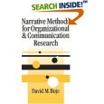
The Rise of ANTENARRATIVE
2001-Antenarrative is BEFORE-narrative & story
Antenarrative is BETS on future
Notes:
Anti-narrative and antenarrative do share this in common: both are beyond the closure required of narrative theory” (Boje, 2001: 3)
“Antenarrative is not the same as ‘anti’-narrative.. In anti-narrative, the person cannot narrate plot or closure, but is in the present moment” e.g. Nancy whose mother has Alzheimer’s (Boje, 2001: 3).

Slide 20
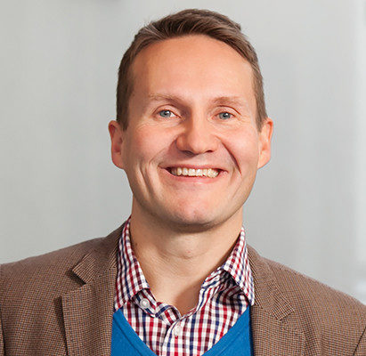
2011 – breakthrough into top-tier
Vaara, E., & Tienari, J. (2011). On the narrative construction of multinational corporations: An antenarrative analysis of legitimation and resistance in a cross-border merger. Organization Science, 22(2), 370-390.

Slide 21
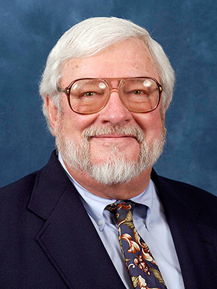
2012 – breakthrough in prospective sensemaking being recognized
Weick, Karl E. "Organized sensemaking: A commentary on processes of interpretive work." Human Relations 65.1 (2012): 141-153.

Slide 22
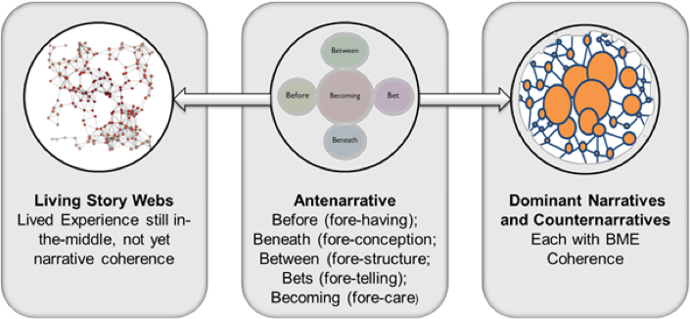
2015 –from 2 B’s to 5B’s
Marita Svane & David Boje collaborate

Slide 23
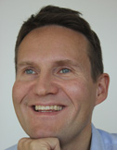
2016 – Antenarrative spreads
Boje, D. M., Haley, U. C., & Saylors, R. (2016). Antenarratives of organizational change: The microstoria of Burger King’s storytelling in space, time and strategic context. Human Relations, 69(2), 391-418.
Boje, D. M., Svane, M., & Gergerich, E. M. (2016). Counternarrative and antenarrative inquiry in two cross-cultural contexts. European Journal of Cross-Cultural Competence and Management, 4(1), 55-84.
Vaara, E., Sonenshein, S., & Boje, D. (2016). Narratives as sources of stability and change in organizations: Approaches and directions for future research. The Academy of Management Annals, 10(1), 495-560.

Slide 24
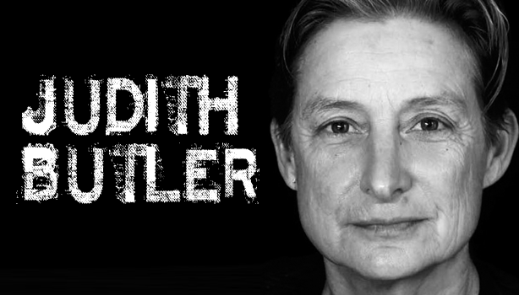
Riach, Rumens, & Tyler (2016)
“Butler-inspired notion of ‘anti-narrative’ interviewing, to which we now turn, in order to develop, in a very practical sense, a method of data generation and analysis that would reflect our methodological commitment to a reflexive undoing of organizational performativity”
See Boje (2001) on anti-narrative & antenarrative

Slide 25
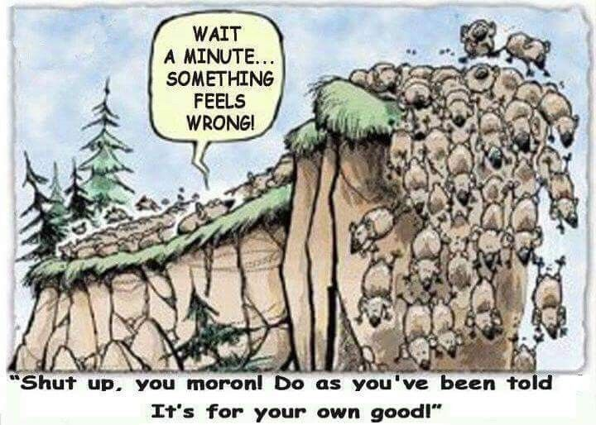
PAUSE for Q&A

Slide 26
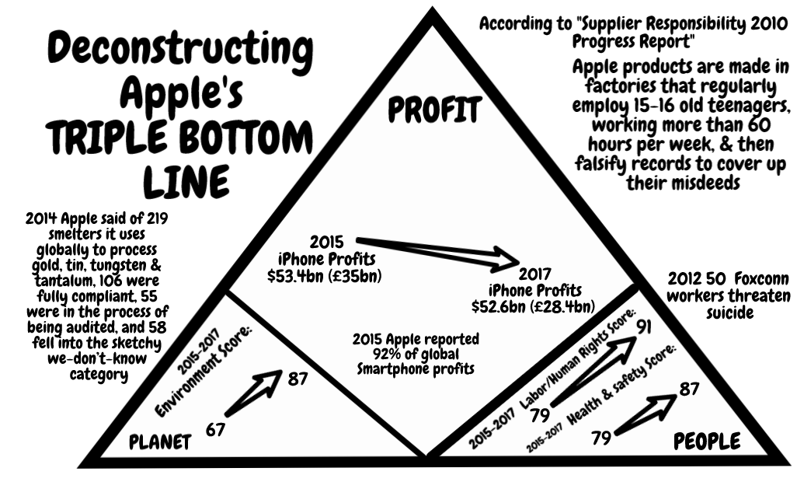
Deconstructing Apple’s CSR narrative

Slide 27
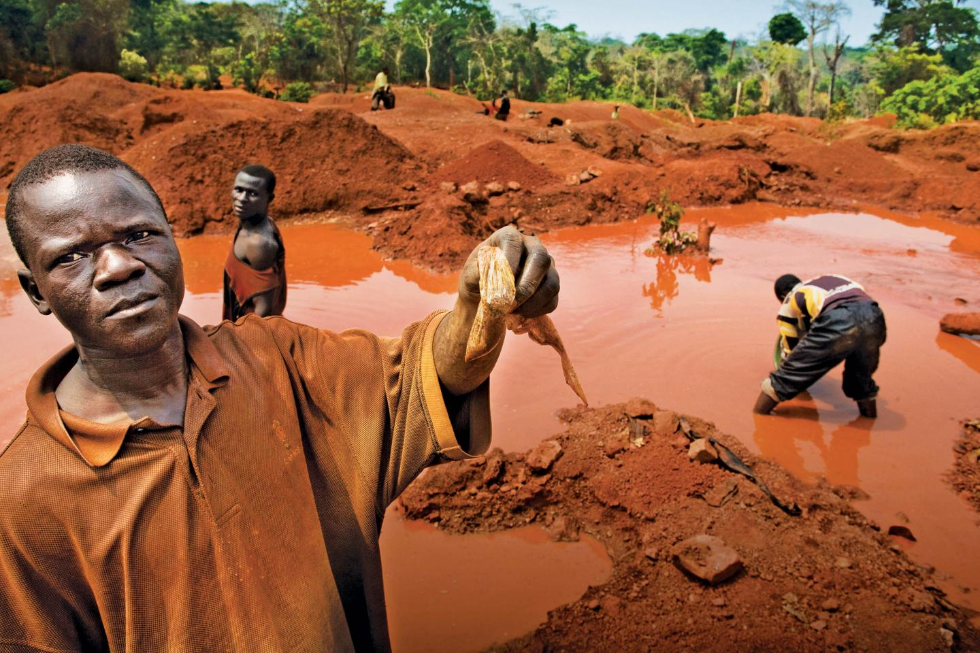
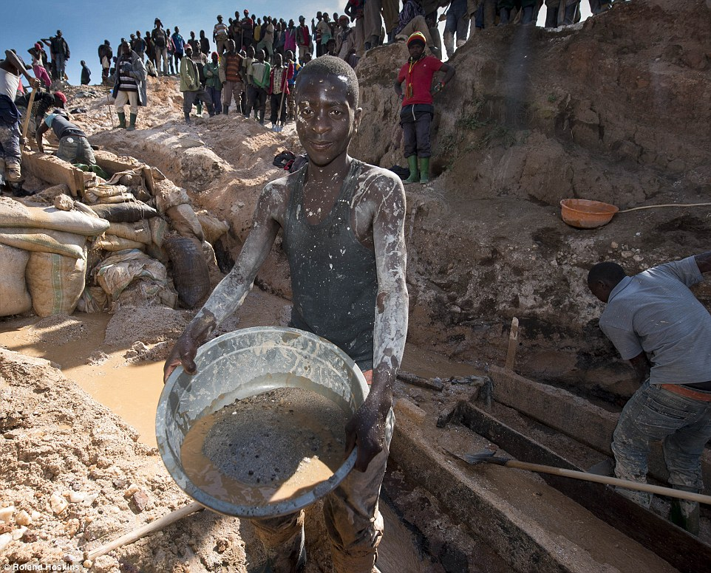
Democratic Republic on of Congo (DRC) HIDDEN COSTS Counternarrative
Notes:
2nd picture http://www.dailymail.co.uk/news/article-3280872/iPhone-mineral-miners-Africa-use-bare-hands-coltan.html

Slide 28
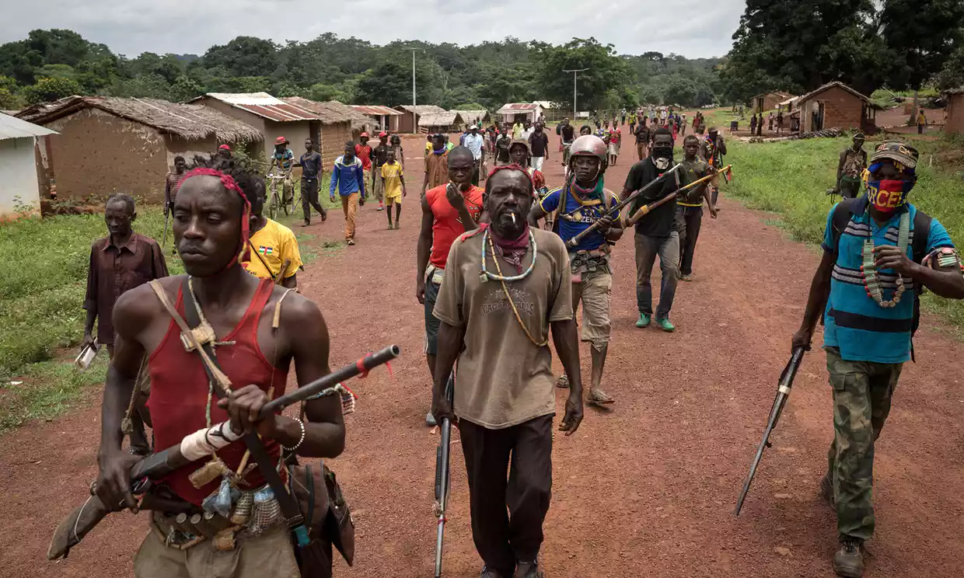
Hidden Costs of Globalization
Notes:
Looting, escalating violence, and more death by rival rebel groups in CAR, as aid organizations withdrew at height of malaria season. One result is women are denied a safe place to give birth. Armed rebels entered a hospital where 7,000 sought refuge, and killed a baby held by its mother. 6 Red Cross volunteers were hilled in an attack on a health center. Health workers have to negotiate with armed people to gain access to villages. Stephen O’Brien a UN emergency relief coordinator, said this is “the early warnings of genocide”.
'People are dying': violence forces aid workers out of Central African Republic, by Rebecca Ratcliffe
Fri 1 Sep 2017 06.04 EDT
Last modified on Mon 11 Dec 2017, accessed Feb 16 2018 at https://www.theguardian.com/global-development/2017/sep/01/people-are-dying-violence-forces-aid-workers-out-of-central-african-republic

Slide 29
Cell-phone’s 3T’s + Gold
CONFLICT MINERALS
Tin is used as a solder on laptop and cellphone circuit boards
Tungsten makes your cellphone vibrate
Tantalum stores electricity on your cellphone
Gold is used to coat the cellphone wiring

Slide 30
Dieselgate
Both narrative & counternarrative are using double negations in a series of dynamical relations back-and-forth.
First negation is a proposition about VW diesel being clean (or not).
Second negation negates the opponent’s negation.

Slide 31
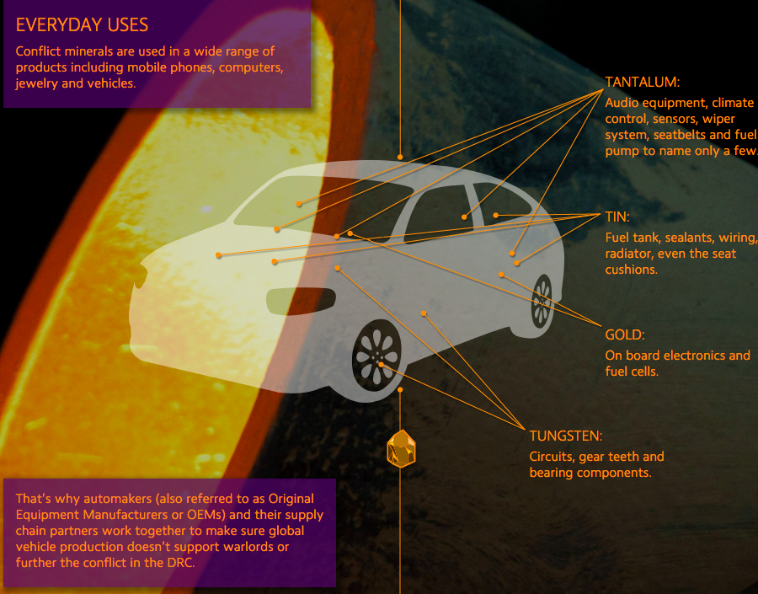
Storytelling of 3T’s in our Cars

Slide 32
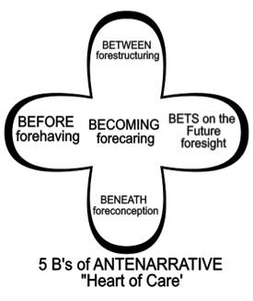
ANTENARRATIVE-BEFORE
The forecaring antenarrative comes into play relatively early. The defeat devices were installed for eight years by VW to make its diesel cars meet legal limits in US. This was forecaring in advance in order for VW (BET ON FUTURE) to become the largest carmaker in the world.
Notes:
Retrofitting software in Europe was a lower cost solution (60 pounds each of about 8 million cars sold in Europe) than recalling 250,000 of 560,00 VW cars sold in the US at cost of $22.6 billion.

Slide 33
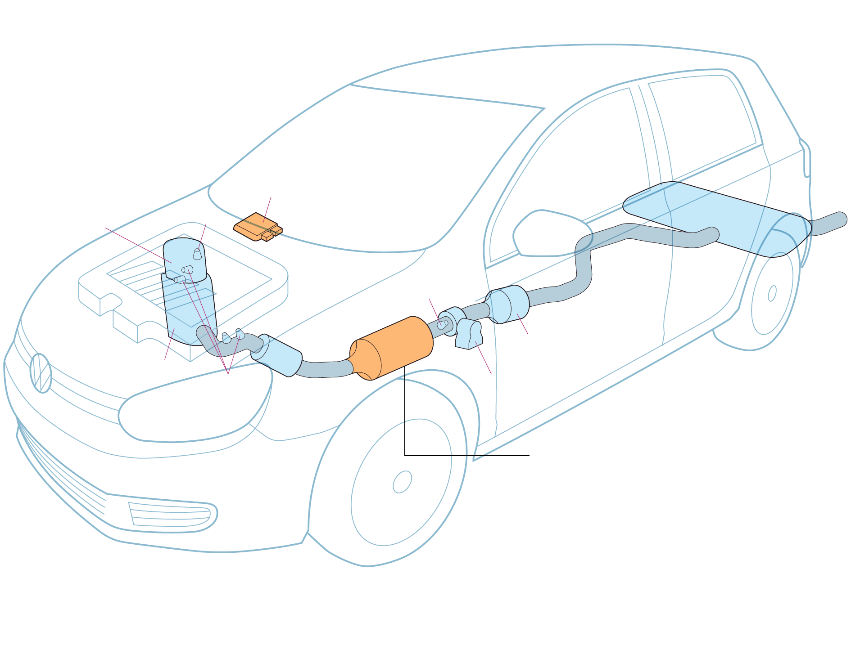
MATERIAL STORYTELLING → DIESELGATE
Main computer
Engine control module senses when car in LAB TEST because steering wheel does not move
Muffler
Diesel oxidation
catalytic converter
& Oxygen Sensor
H2S Catalytic Convert
Nitrogen oxide trap - Reduces toxic emissions. Engine used more fuel when trap engaged. Computer saves fuel by allowing more pollutants to pass through exhaust
Temperature Sensors

Slide 34
ANTENARRATIVE-BENEATH
Specific discursive-material (fore)concepts, documents, symbols, language, including print and TV ads, were designed in advance in order to sell ‘dirty’ diesel cars as ‘clean’ diesel. A way of telling had to be invented that keep most employees, most government officials, and the public, not in the know.

Slide 35
ANTENARRATIVE BETWEEN
Forestructuring - Actual material devices (switches, computer software) were developed in advance to allow the emission controls to be defeated. EUGTI a junk research company funded by BMW, Mercedes and VW paid $230,000 to conduct a study using ten Macaque monkeys in Albuquerque, New Mexico.

Slide 36
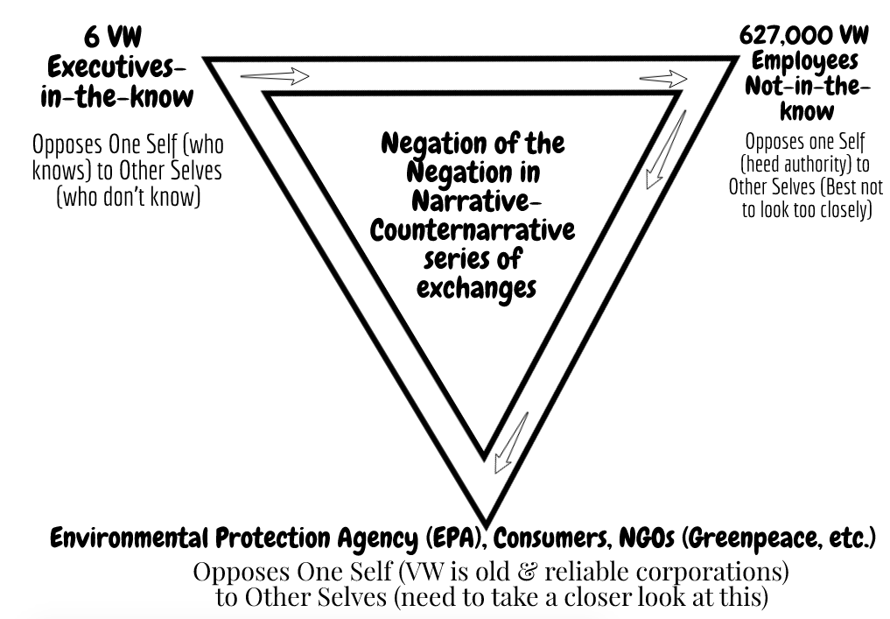

Slide 37
ANTENARRATIVE BETS
Foresight- Dieselgate involves systematic collusion by German government and VW (& many other diesel car makers) in order to enter the US market, keep the Euro market share, knowing in advance, that a cheat device was being used, while advertising its cars as ‘clean diesel’.
Notes:
Euro manufactories have long range plan to meet pollution standards, but cars in Europe are 6 to 8 times what the standards allow. Germany alone has 10,000 deaths a year due to increases in NOx from diesel cars and trucks.

Slide 38
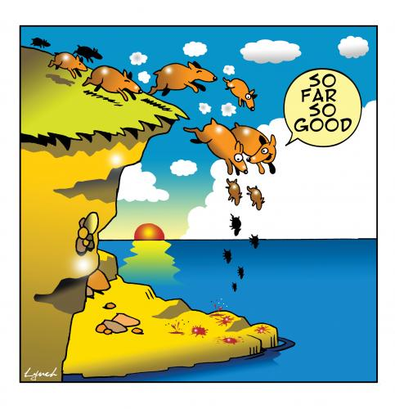
As we approach 6th Extinction

Slide 39
Forecaring in not so ethical way
It was 60 months of intense back and forth interaction with VW. CARB would do testing, generate questions for VW, and they would provide answers from Wolfsburg
6 executives admitted to a long trail of deceit and misdirection.

Slide 40
In Sum
At the antenarrative level, there is active forecaring in advance of an entire automotive industry, and collusion with governments, and NGOs not sophisticated enough in science or engineering to spot global fraud. Dieselgate could tear down the reputation of the German car industry and its economy along with it. Therefore, the storytelling strategy was to prevent that through obstacles and obfuscation to draw it out as long as possible.

Slide 41
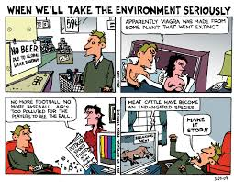
Pause for Q&A
Notes:
See Vinnarei & Laine (2017) The moral mechanism of counter accounts: The case of industrial animal production. Accounting Organizations and Society. Vol. 57: 1-17.

Slide 42
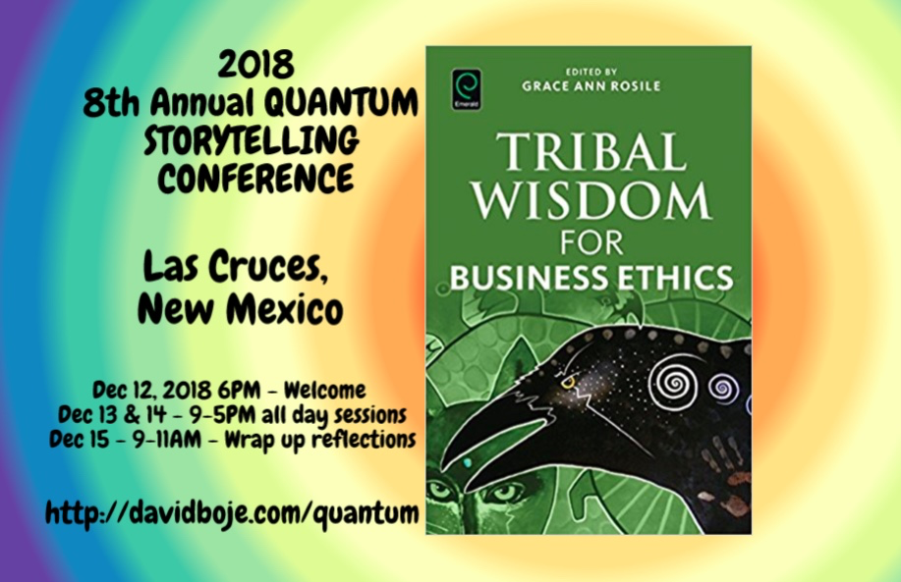
THANK YOU
Question & Answers about STORYTELLING
Slides & books at http://davidboje.com/Finland

